Slide 1
Lab 2 : Nibbles
By: CS 382 CAs

Slide 2
Endianness & Pointers Recap

Slide 3
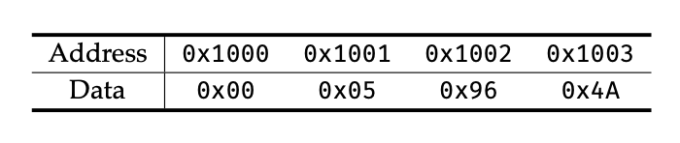
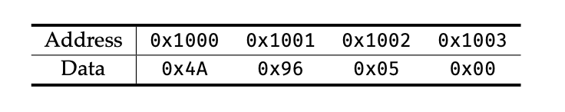
Endianness
Endianness refers to the order in which bytes are stored in memory.
Let's say we have the integer 366,154 (0x5964A)
Big endian: Bytes are stored in "normal order” From MSB to LSB
Little endian: Bytes are stored bottom up
From LSB to MSB
Most machines are little endian but not all. Mainly for historical efficiencies.

Slide 4
Endianness Example
int main(int argc, char const* argv[]) { int arr[] = {0xDEADBEEF, 0xCAFEFEED, 0x8BADF00D}; // Array of 3 integers char* arr2 = (char*) arr; // Cast the array to a char pointer for (int i = 0; i < 3; i++) printf("%x\n", arr[i]); // Print the integers printf("------------\n"); for (int i = 0; i < 12; i++) printf("%02hhx ", arr2[i]); // Print the chars }
Output:
deadbeef
cafefeed
8badf00d
------------
ef be ad de ed fe fe ca 0d f0 ad 8b

Slide 5
Pointers
Pointers store the memory address of a variable. This allows direct access and manipulation of data in memory.
Like other variables, pointer values can be changed.
Improper pointer manipulation may result in invalid memory access, causing crashes or data corruption.
int a = 42; int *ptr = &a; // ptr now holds the address of 'a'

Slide 6
Pointer Casting
By casting a pointer, we can choose which part of the data we take. i.e., when we downcast a uint16_t* to a uint8_t*, when dereferenced, only the lower 8 bits are read due to the downcast.
You can upcast, but unless you know exactly what you're doing, you may end up with "garbage" data.

Slide 7
Example
#include <stdio.h> #include <stdint.h> int main(int argc, char* argv[]) { uint64_t big_data = 0xeeeeeeeeddddccba; uint64_t smaller_data = *(uint64_t*) &big_data; uint32_t even_smaller_data = *(uint32_t*) &big_data; uint16_t almost_smallest_data = *(uint16_t*) &big_data; uint8_t smallest_data = *(uint8_t*) &big_data; // what does the program print? printf("0x%016llx\n", smaller_data); // 0xeeeeeeeeddddccba printf("0x%016llx\n", even_smaller_data); // 0x00000000ddddccba printf("0x%016llx\n", almost_smallest_data); // 0x000000000000ccba printf("0x%016llx\n", smallest_data); // 0x00000000000000ba return 0; }

Slide 8
Lab 2 Assignment

Slide 9
Peek at the Starter Code
#include <stdio.h> #include <stdlib.h> void int_to_nibble(int intarr[], int nint, unsigned char nibarr[], int nnibs) { /* Your code here */ } int main(int argc, char const* argv[]) { int arr[3] = {0x12BFDA09, 0x9089CDBA, 0x56788910}; // Initialize all elements to 0; unsigned char nibs[24] = {0}; int_to_nibble(arr, 3, nibs, 24); // Print each nibble in hex for (int i = 0; i < 24; i++) printf("%1hhX ", nibs[i]); return 0; }
The goal of the lab is to transform an array of nint intgers into nnibs nibbles
Use shifting and masking to accomplish this

Slide 10
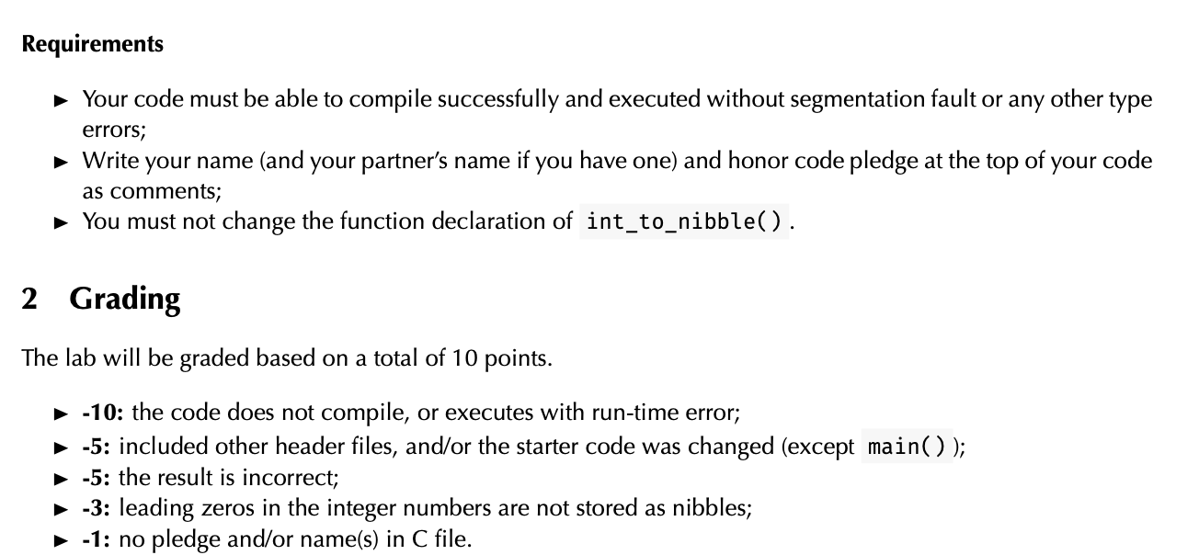
Hints, Restrictions, Requirements
Hint: Use masking and shifting to extract nibbles from an integer
Think about how the integers are laid out in memory...
As always, pay attention to the requirements of the writeup pdf on canvas:

Slide 11
How to Compile & Run your lab2.c
In your terminal:
gcc <some_file>.c -o <name_of_output>
- Enter “ls”, see you have an executable file called <name_of_output> - If you don't specify output, your output file will be named a.out
Provided you don’t have errors, run it with:
./<name_of_output>
- We could be using makefiles like in 385, but it is not necessary for this assignment.

